Slide 1
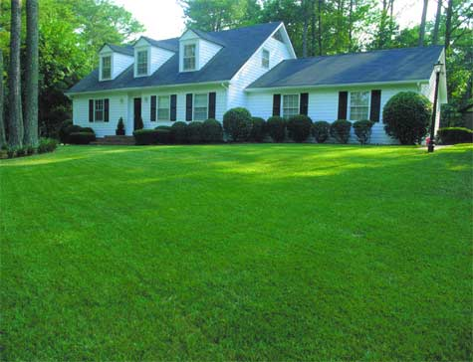
Smart Sprinkler System
Project Goal: The goal of this project is to create a system where a person’s lawn is routinely probed and cared for by an automatic sprinkler system.
Deliverables
Fall 2015: Robot w/ probe, weather monitoring via internet, w/ interface app
Spring 2016: Robot charging station, Robot collision-avoiding sensors, pathing memory within box, controller connected to sprinkler system
Team 24: Coy Coburn, Daniel Miller, Michael Turner, Tyler Castro
Robot manuevering
Sprinkler setup
Power
Robot sensors
Interface app
Controller box communication
Robot probe
Internet connection

Slide 2
Subsystem | Primarily Responsible Team Member | Student Responsibilities/ Tasks
Power | Daniel | Prepare the necessary power supply for both the probe as well as the sprinkler system.
Controller box communication | Coy | Create a connection between the master controller with its slave connections; these include the probe, the sprinkler system, and the interface app.
Robot maneuvering | Daniel | Enhance the robot’s ability to maneuver off-terrain and possess the ability to set a route for probing locations.
Robot sensoring | Michael | The robot will need the functions to sense its surroundings and take necessary precautions to avoid obstacles and safely maneuver a lawn.
Robot probe | Tyler | A probe will be set to sample water moisture in multiple locations in the lawn and reset said probe.
Sprinkler setup interface | Tyler | The sprinkler system will have the functions to design and manipulate the weekly settings for lawn care with data from probe and internet.
Interface app | Coy | A mobile app will be created for a user to view sprinkler settings as well as make changes to planned watering for the week or its default.
Internet connection | Michael | The sprinkler master controller will need to connect to weather websites via internet so to plan watering settings for the upcoming week.

Slide 3
Subsystem | Subsystem Tasks | Needs
Power | Provide power to robot, charger, and controller box | Needs to be waterproof
Controller box communication | Control robot, receive and interpret information from internet | Needs to be able to remember pathing
Robot maneuvering | Allow robot to move efficiently through grassy terrain | Needs to have robot maintain composure during drilling
Robot sensoring | Keep robot from hitting unexpected objects | Needs infrared technology, emergency gyroscope to detect flipping
Robot probe | Detect moisture in ground through a drill | Needs to be sturdy enough to not be damaged during drilling
Sprinkler setup | Ordinary sprinkler system, activates according to collected data | Needs to be able to branch according to what needs water
Interface app | Keeps user up to date on expected sprinkling | Needs to be simple and user-friendly
Internet connection | Connects app to weather data online, feeds info to app and controller box | Needs to have reliable connection

